Slide 1


StatsWrap
Make your workout work for you
Alex Laughlin & Tino Pimentel

Slide 2
Our Vision
For a fitness enthusiast that likes to know every intimate detail of their workout, StatsWrap is an activity tracker that records and graphs all of one’s fitness data in real time. This allows athletes to customize their workouts with incredible accuracy. Unlike competitors, StatsWrap focuses on keeping your data secure and presenting high fidelity information in a concise live graph.

Slide 3

Software Requirements
Java 8.0 or newer
Scenebuilder
JavaFX
Windows 7/10 or iOS or Linux 13.0
Gadgetbridge
PostgreSQL

Slide 4

Hardware Requirements
Light sensor
Minimum 128 MB of Storage
Minimum 128 MB of Memory (RAM)
Intel Pentium 2 266 Mhz processor
Micro-USB cable

Slide 5

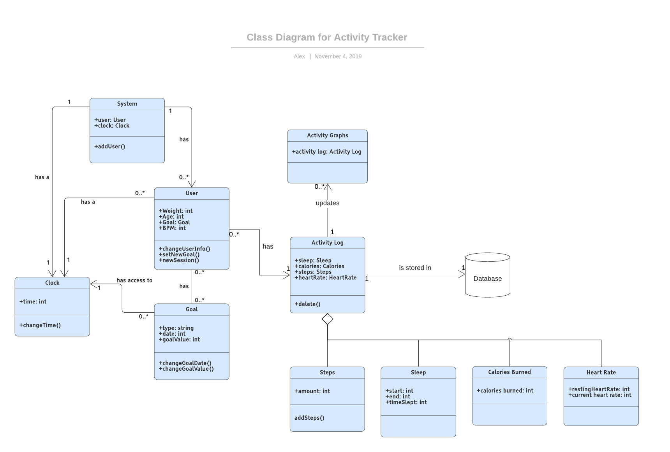
System Design

Slide 6

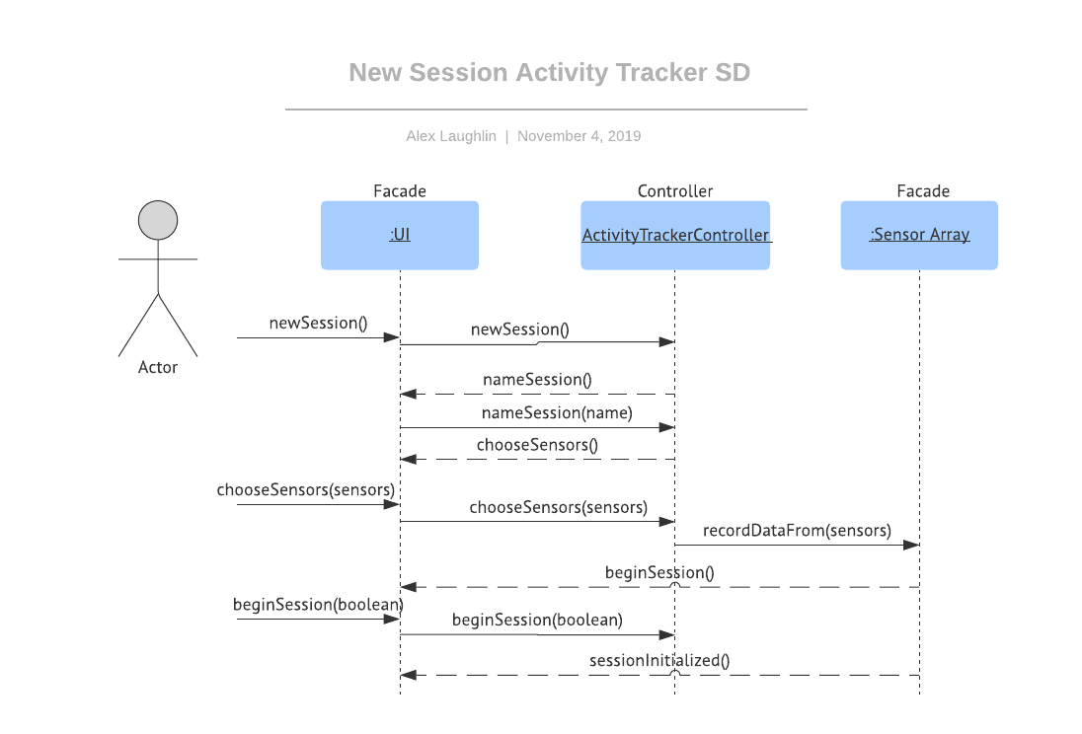
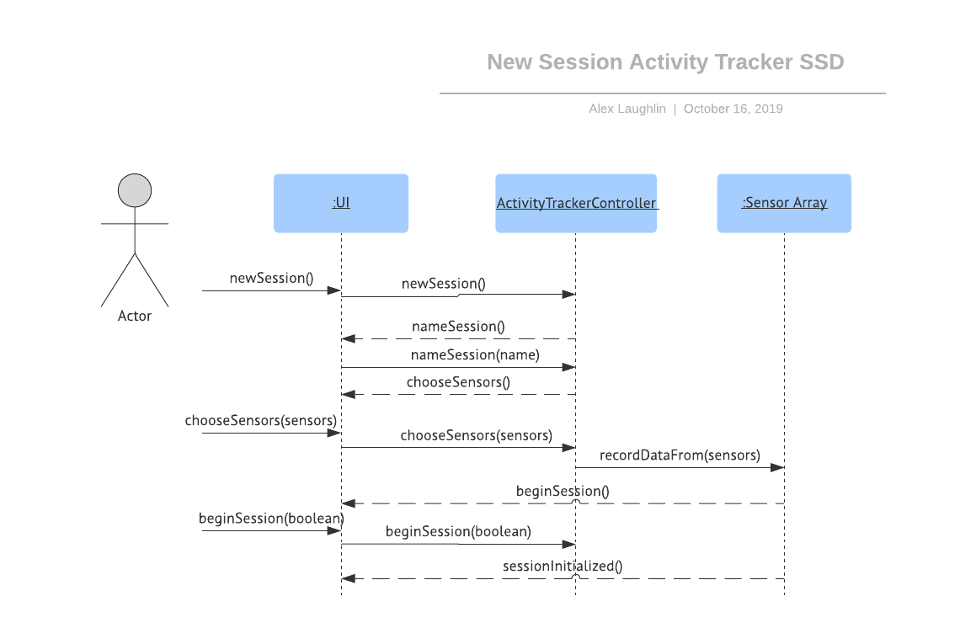
New Session? No Problem!

Slide 7
With StatsWrap, creating a new session is just a click away at any moment. Log any kind of activity you’d like to customize your workout to your needs.

Slide 8

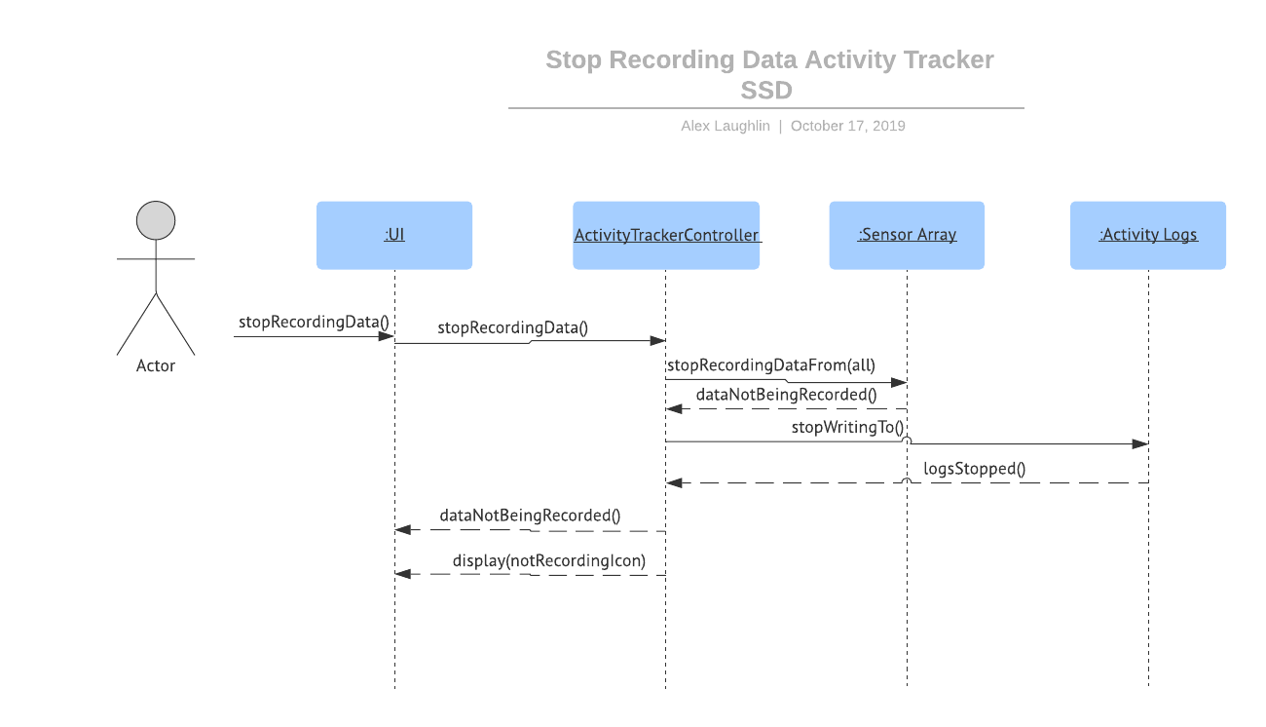
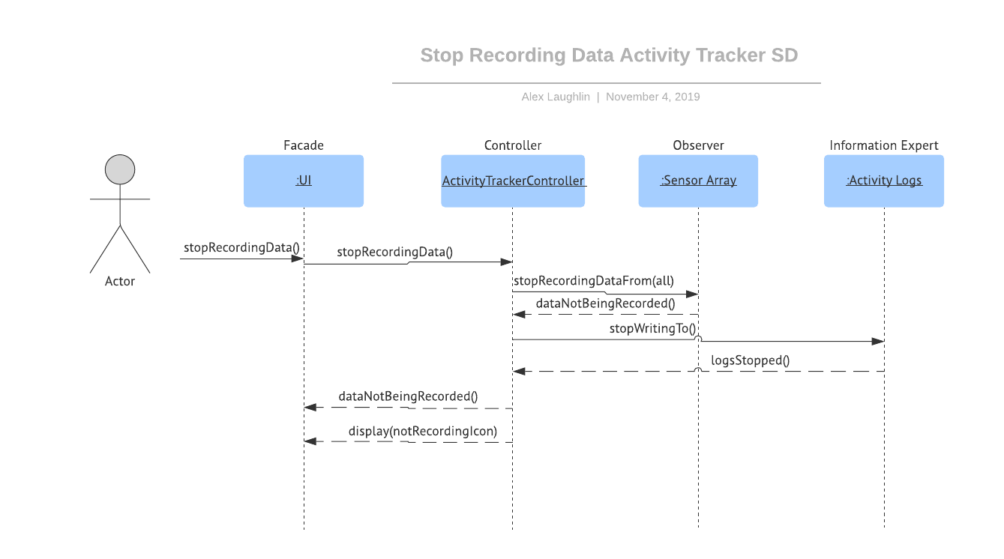
Maintain your privacy easily with StatsWrap

Slide 9
Keep YOUR data in YOUR hands! StatsWrap users can stop recording data at the press of a button to maintain their privacy.

Slide 10

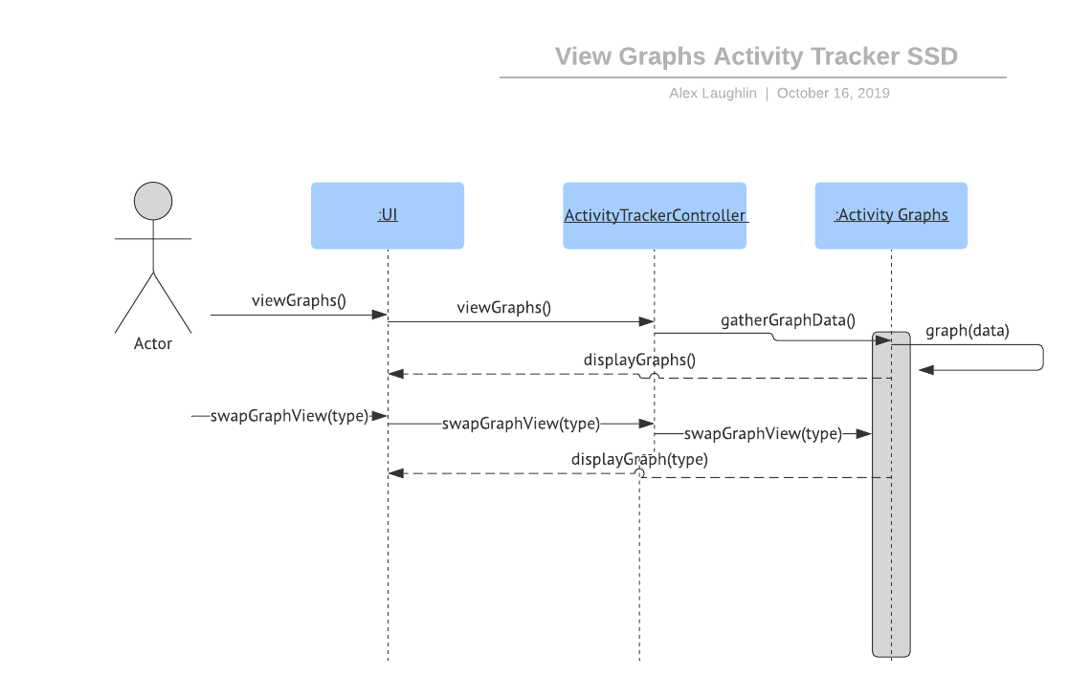
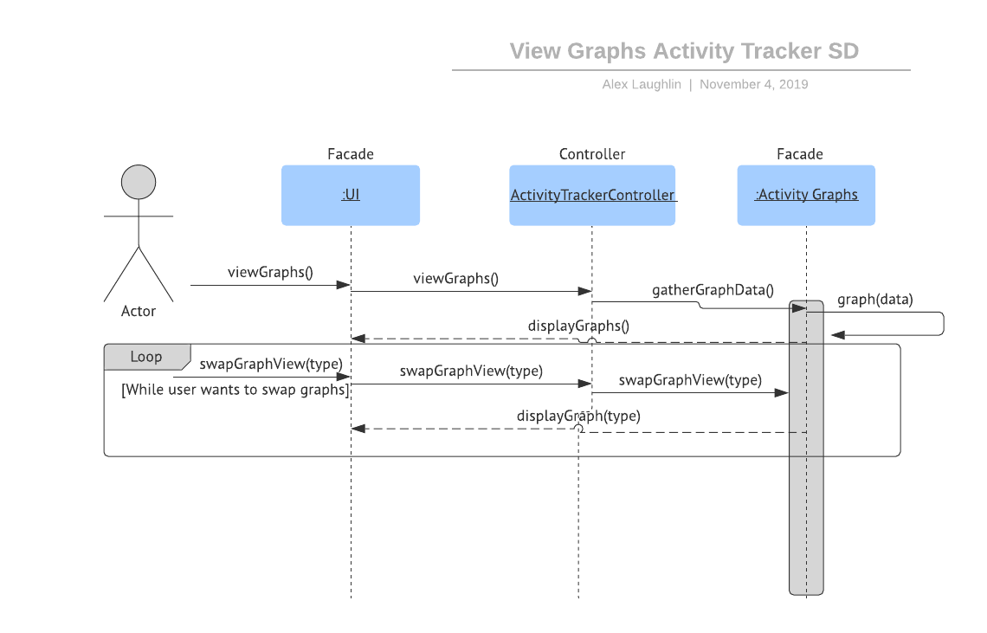
View your activity graphs at a glance to nail your workout goals

Slide 11
StatsWrap is designed with workouts in mind. Are you hitting your mile pace? Have you taken enough steps today? Find out in seconds with StatsWrap’s live activity graphs.

Slide 12

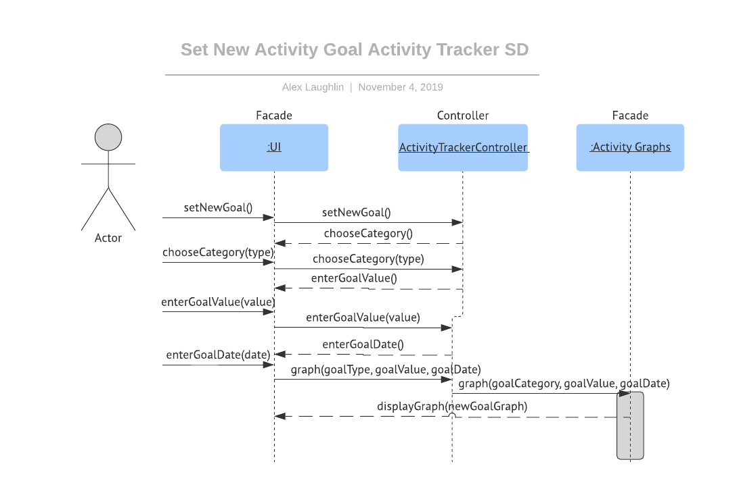
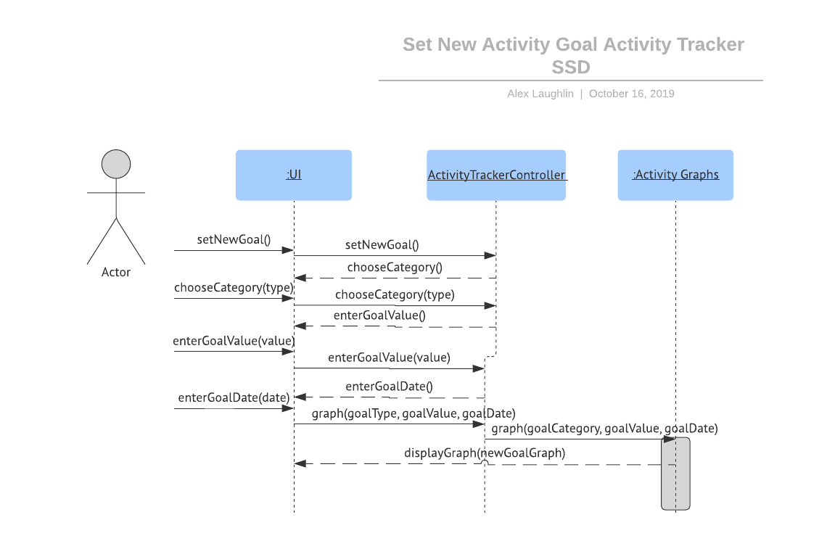
Stride towards excellence with StatsWrap’s goal setting feature

Slide 13
If your goals are becoming too easy, dream bigger with StatsWrap! Set a new activity goal in any category with StatsWrap’s new goal setting feature.

Slide 14

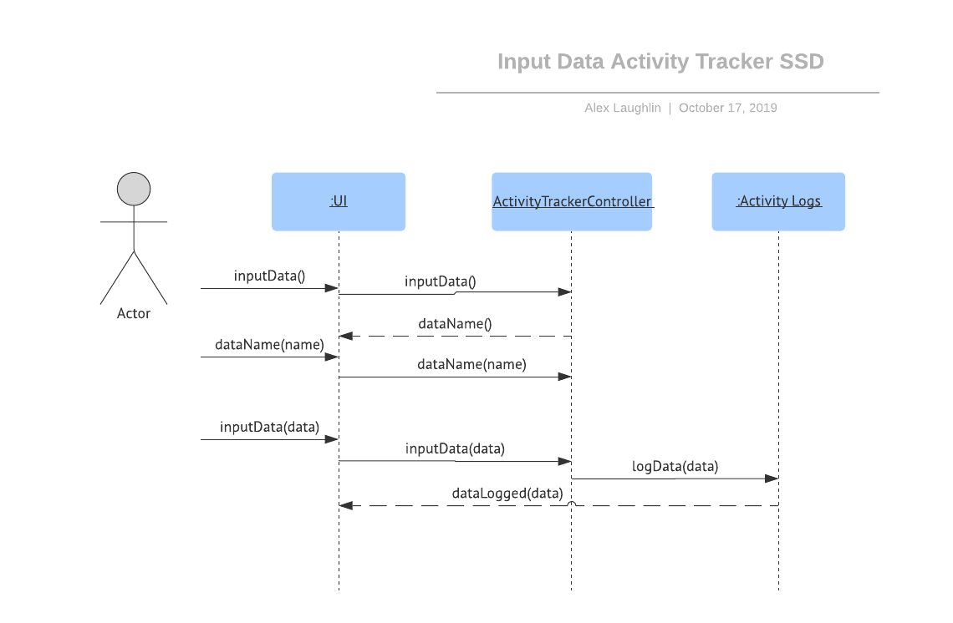
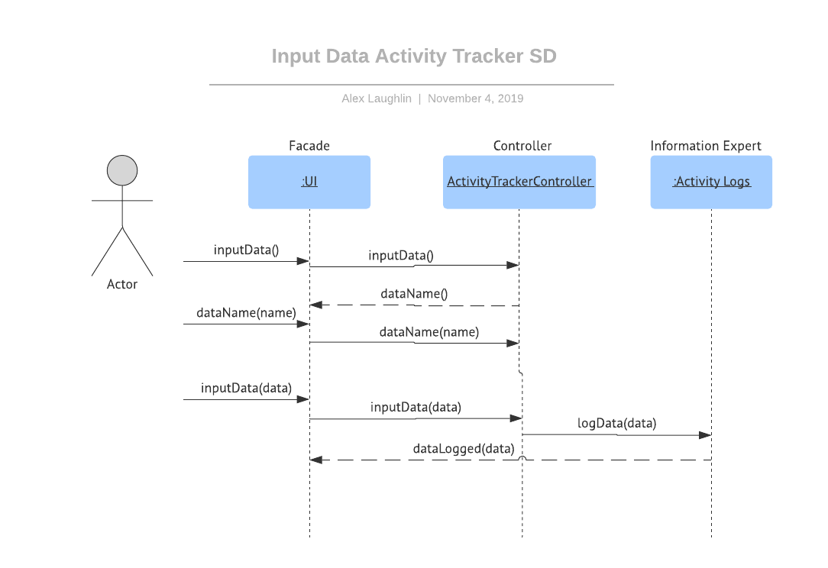
Track customized statistics easily with StatsWrap!

Slide 15
With the power of StatsWrap at your fingertips, you can track anything you’d like! Enter your weight, calories consumed, mood, or anything else that affects your workout to maximize your performance.

Slide 16
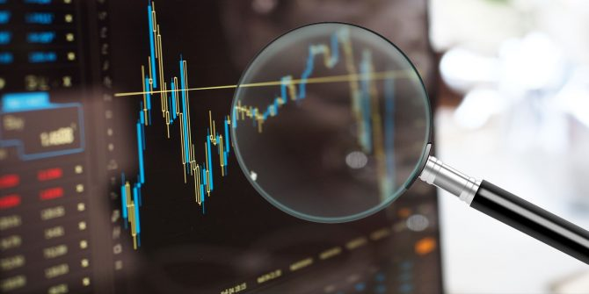
Analysis
When we began this project our goal was to create an activity tracker better than Fitbit. That may have been a tad ambitious. Nevertheless, StatsWrap came together well. In our very biased opinions, StatsWrap has some aspects that are better than competitors. The ease of use, instant readability, and security features are the greatest features of StatsWrap. It’s minimalistic input/output options remove the fear of sensitive data loss through Bluetooth or Wi-Fi. The live graphs function well to guide a workout. While it may have the most bells and whistles, StatsWrap is a must-have this holiday season.

Slide 17

StatsWrap
Make your workout work for you

Slide 18
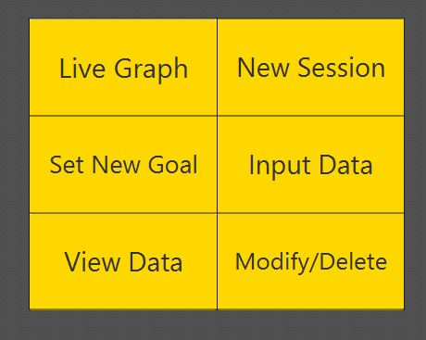
Main Menu

Slide 19
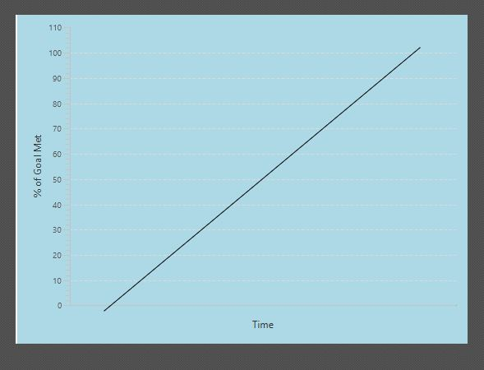
Live Graph

Slide 20
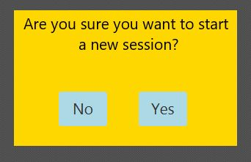
New Session

Slide 21
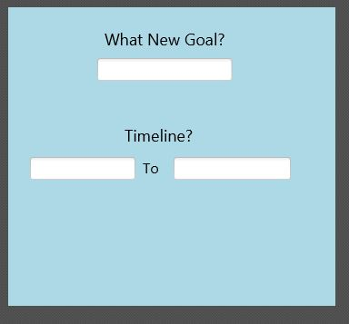
Set New Goal

Slide 22
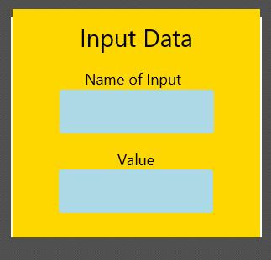
Input Data

Slide 23
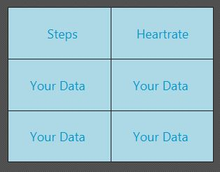
View Data

Slide 24
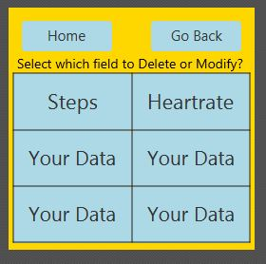
Delete/Modify

Slide 25
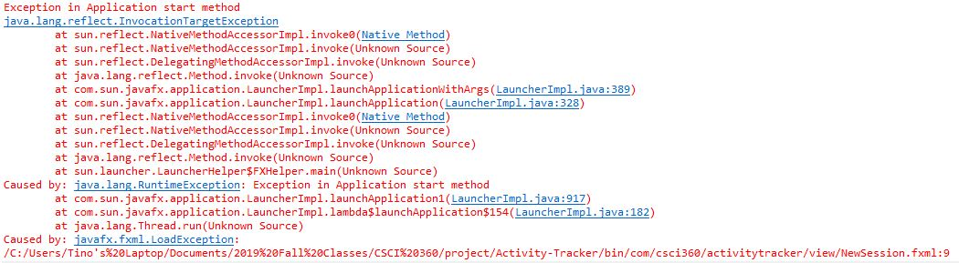
Problems
When executing JavaFX code with FXML files included, Exception error continues.

Slide 26
Looking Forward
Complete transitions from buttons
Add Home and Back buttons for every screen.
Take input from text boxes on GUI
Finish implementing the rest of our classes / controllers. (ETA by November 14th).

